Slide 1
Solution Final Exam COMPUTER NETWORKS Fall 2010 - 2011

Slide 2
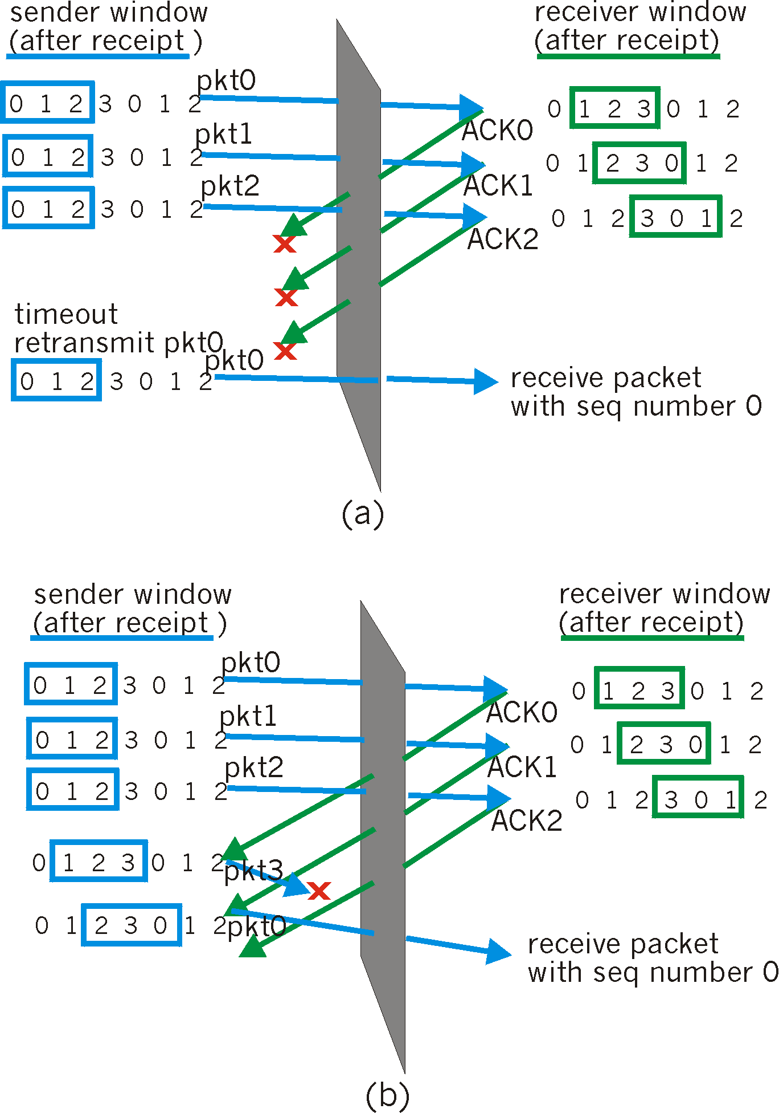
Solution Q1
seq #’s: 0, 1, 2, 3
window size=3

Slide 3
Sol Q2. sender: handles flipped bits in data pkts and garbled ACK/NAKs
rdt_send(data)
sndpkt = make_pkt(0, data, checksum)
udt_send(sndpkt)
rdt_rcv(rcvpkt) &&
( corrupt(rcvpkt) ||
isNAK(rcvpkt) )
Wait for call 0 from above
Wait for ACK or NAK 0
udt_send(sndpkt)
rdt_rcv(rcvpkt)
&& notcorrupt(rcvpkt)
&& isACK(rcvpkt)
rdt_rcv(rcvpkt)
&& notcorrupt(rcvpkt)
&& isACK(rcvpkt)
Λ
Λ
Wait for ACK or NAK 1
Wait for
call 1 from above
rdt_rcv(rcvpkt) &&
( corrupt(rcvpkt) ||
isNAK(rcvpkt) )
rdt_send(data)
udt_send(sndpkt)
sndpkt = make_pkt(1, data, checksum)
udt_send(sndpkt)

Slide 4
Sol. Q3
Premature RTT will result in frequent retransmission of correctly received packet. Hence, unnecessary increasing the network traffic.
Too long RTT selection will increase the wait time at the source. Hence, increasing the file/data transfer time.
EstimatedRTT = (1- α)*EstimatedRTT + α*SampleRTT
Setting the timeout
EstimtedRTT plus “safety margin”
large variation in EstimatedRTT -> larger safety margin
first estimate of how much SampleRTT deviates from EstimatedRTT:
DevRTT = (1-β)*DevRTT +
β*|SampleRTT-EstimatedRTT|
(typically, β = 0.25)
Then set timeout interval:
TimeoutInterval = EstimatedRTT + 4*DevRTT

Slide 5
Sol Q4
Object (O) = 1 Mb
Segment size (S) = 1024B = 8192 bits
Window Size (W) = 8
RTT = 1 sec
Link b/w client and server = 1 Mbps (your own assumption)
Number of Windows required for transfer (K) = O/WS =15.25 = 16
Since WS/R < RTT + S/R therefore using the following formula for delay
Delay = 2 + 1 + 15 (1.008192 - 0.065536) = 17.14 sec
delay = 2RTT + O/R
+ (K-1)[S/R + RTT - WS/R]

Slide 6
Sol Q5.
length
=4800
ID
=x
fragflag
=0
offset
=0
One large datagram becomes
several smaller datagrams
length
=1500
ID
=x
fragflag
=1
offset
=0
length
=1500
ID
=x
fragflag
=1
offset
=1480
length
=1500
ID
=x
fragflag
=1
offset
=2960
length
=360
ID
=x
fragflag
=0
offset
=4440

Slide 7
Sol Q6a.
Y
X
Z
X
Y
Z
Z
9
3
Z
6
50
Link cost b/w Y and Z changes from 3 to 1
Y
X
Z
X
Y
Z
Z
9
1
Z
4
50

Slide 8
Sol Q6b.
Y
X
Z
X
Y
Z
Z
9
3
Z
6
50
Link cost b/w Y and Z changes from 3 to 62
Y
X
Z
X
Y
Z
Y
X
Z
X
Y
Z
Z
9
62
Z
12
50
Z
15
62
Z
18
50
It will continue to change until the following
X
Y
Z
Y
X
Z
X
Y
Z
Z
54
50
Z
53
62
Z
56
50

Slide 9
Sol. Q7
Step
0
1
2
3
4
5
start N
F
FE
FED
FEDC
FEDCA
FEDCAB
D(D),p(D)
2,F
D(E),p(E)
1,F
D(A),p(A)
Infinity
Infinity
5,D
D(B),p(B)
Infinity
Infinity
7,D
D(C),p(C)
Infinity
3,E

Slide 10
Sol Q8.a. Ethernet CSMA/CD algorithm
1. Adaptor receives datagram from net layer & creates frame
2. If adapter senses channel idle, it starts to transmit frame. If it senses channel busy, waits until channel idle and then transmits
3. If adapter transmits entire frame without detecting another transmission, the adapter is done with frame !
4. If adapter detects another transmission while transmitting, aborts and sends jam signal
5. After aborting, adapter enters exponential backoff: after the mth collision, adapter chooses a K at random from {0,1,2,…,2^{m}-1}. Adapter waits K·512 bit times and returns to Step 2

Slide 11
Sol Q8.b.
K * 512 bit time
K = {0,1,2 ….. 1023}
Min value of K = 0
Max value of K = 1023
Single bit time = 0.0000002 sec
Min wait time = 0 (512 x .0000002) = 0 sec
Max wait time = 1023 (512 x .0000002) = 105 m sec

Slide 12
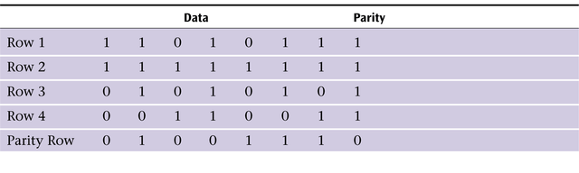
Q9a.
Q9b.
M = 1010001011
Let 4 bit CRC polynomial G = 1001
Then remainder or CRC bits = 001

Slide 13
Q10a.
HUB: It acts as a repeater and operates at the physical layer. Data on port of the hub is transmitted to all the ports (broadcast)
Switch: It operates at layer two or link layer. Switching is done on the basis of MAC address.

Slide 14
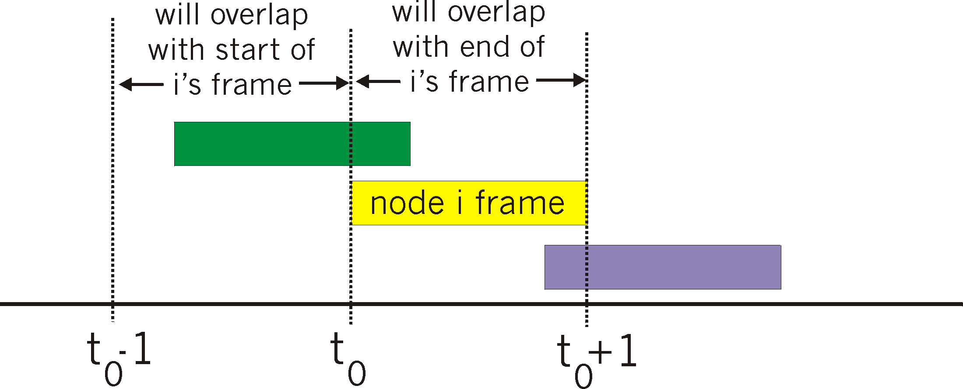
Q10b.
ALOHA
unslotted Aloha: simpler, no synchronization
when frame first arrives
transmit immediately
SLOTTED ALOHA
all frames same size
time is divided into equal size slots, time to transmit 1 frame
nodes start to transmit frames only at beginning of slots
when node obtains fresh frame, it transmits in next slot
no collision, node can send new frame in next slot
if collision, node retransmits frame in each subsequent slot

